Slide 1
Fraud Detection in Online Transactions
Quan Nguyen Hien
Vinh Nghiem To

Slide 2
Table of Contents
01
02
03
04
Problem & Solution
Increasing trend in online fraudulent
Data Resources
IEEE-CIS Fraud Detection
Analysis / Insights
Interesting Insights
Data Mining
Training, fitting, and evaluating the models

Slide 3
01
Problems & Solutions

Slide 4
Understanding the Problem
Types
Increasing trend
Data Mining
Card-present, Card-not-present fraud
Up to 108% from 2015 to 2018
Save time and money

Slide 5
Our Assumptions
Distance
Email Domain
01
02
Distance has positive correlation with probability of Fraudulent
Unpopular Email domain might be suspicious
Amount’s Decimal
Cards
03
04
Multiple decimals might be suspicious
(e.g., $9.99 has 2 decimal places)
There should be indifference among usage of credit cards

Slide 6
02
Datasets Overview

Slide 7

Dataset Overview
From Kaggle Competition
590540 observations
45K
394
41
Online Tracked Factors
Identity Tracked Factors
Notes:
Observations len tren

Slide 8
03
Analysis / Insights

Slide 9
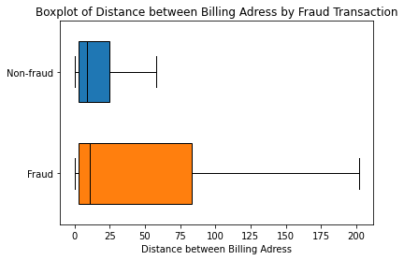
Distance
Distribution of Fraud vs Non-Fraud
98%
2%
Analysis
Fraudulent transactions are located much further than normal transactions
The distance from the purchaser to the recipient is important to the predictive model
Transactions from foreign email domains have a higher probability of committing fraud
Boxplot of distribution of distance within Fraud and Non-Fraud Transactions

Slide 10
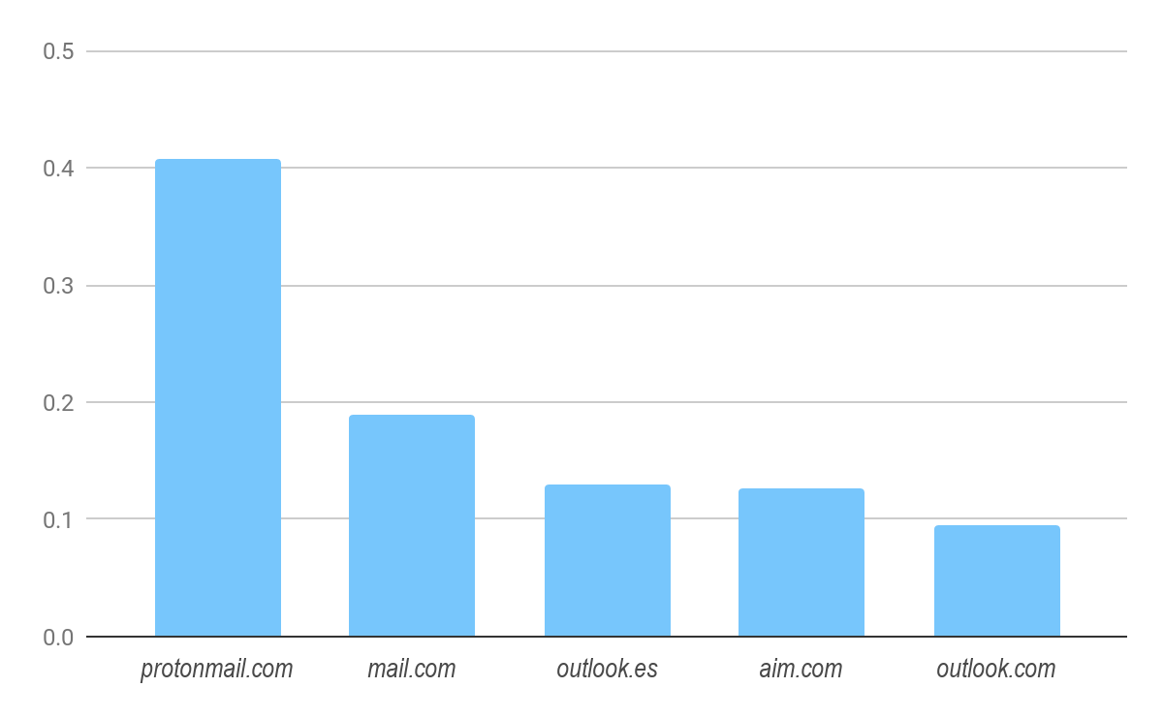
Email Domain
Analysis
Top 5 Email Domain
Protonmail.com: encrypted domain
Mail.com, aim.com: little info
Outlook.es: foregin domain
Top 5 email domain with highest probability of committing fraud

Slide 11
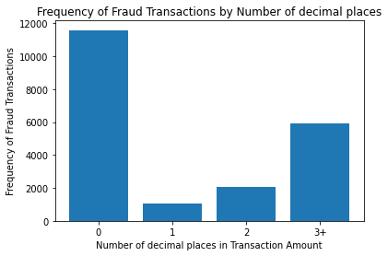
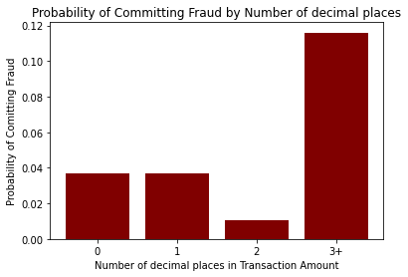
Transaction’s Decimal Places
Transactions with > 3 decimal places will be grouped as 3
3 decimal places have much larger fraud probability

Slide 12
04
Data Mining

Slide 13
Results
Neural Network
Highest macro F-1 score of 0.70
Support Vector Machines
Logistic Regression
Decision Tree
Macro F-1 score: 0.58
Macro F-1 score: 0.52
Macro F-1 score: 0.55
Average Accuracy: 97.1%
Average Accuracy: 95.6%
Average Accuracy: 96.4%
Average Accuracy: 96.2%

Slide 14
References
Abdallah, Maarof, Zainal. “Fraud detection system: A survey.” Journal of Network and Computer Applications, no. 68, 2016, pp. 90-113.
Bhattacharyya, Jha, et al. “Data mining for credit card fraud: A comparative study.” Decision Support System, no. 50, 2011, pp. 602-13.
Chen, Zhang, et al. “A Method for Online Transaction Fraud Detection Based on Individual Behavior.” ACM TURC-AIS 2019 Conference on Artificial Intelligence and Security, 2019.
Patil, Soni. “Predictive Modelling for Credit Card Fraud Detection using Data Analytics.” Procedia Computer Science, no. 132, 2018, pp. 385-95.
Harrow. “Is Your Credit Card Less Secure Than Ever Before?” Forbes, April 2018. https://www.forbes.com/sites/robertharrow/2018/04/20/is-your-credit-card-less-secure-than-ever-before/?sh=1b5c3b105c8d

Slide 15
Thanks!
Do you have any questions?

